Slide 1
Optimizing URL Phishing Detection: A Manifold Learning Approach with an Efficient Neural Network Focused on Reducing Computational Cost
2024 IEEE International Students' Conference on Electrical, Electronics and Computer Science
Paper ID: 449
Vijay Venkatesh M
Master of Computer Applications (M.C.A.)
Department of Computer Science
University of Madras

Slide 2
Problem Statement
The growing number of phishing attacks is one of the top concerns of security researchers.
IBM’s Cost of Data Breach Report: ‘Phishing becomes the costliest cause of compromising information’ [4].
CISCO Report: ‘At least one individual clicking a phishing link from an organization is about 86%’ [1].
Computational cost of existing approach:
Dataset with higher dimensional feature space.
Models with highly complex architecture.

Slide 3
Approach & Contribution:
Manifold Learning
Integration of Isomap Algorithm to reduce the data dimension.
Simplified Neural Network Architecture
3 Layers & Minimal nodes
Activation Functions with less computational complexity
Optimization with momentum and velocity
Derivation of well approximated time complexity of the proposed model

Slide 4
Literature Review
Ref | Algorithm | Accuracy
[9] | CatBoost | 96.9%
[9] | XGBoost | 92.1%
[9] | Light GBM | 95.2%
[10] | PUCNN | 95.7%
[7] | LSTM and CNN hybrid | 93.28%
Table I: Summary of Related Works

Slide 5
Dataset Summary & Feature Engineering:
Source: Mendeley Data [11]
Size: 50,000 Phishing & 30,000 Legitimate URLs
Limited Size: 10,000 URLs
Volatility of URLs
Observing Model Performance
third-level
Domain
second-level
Domain
top-level
Domain
protocol
directory
file
https://www.exampleweb.com/home/login.html
Subdomain
name
domain name
page
Final Dataset Dimension: 10,000 x 30
host name
path

Slide 6
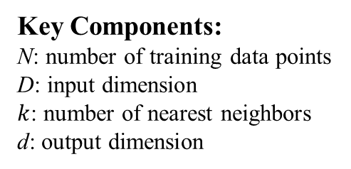
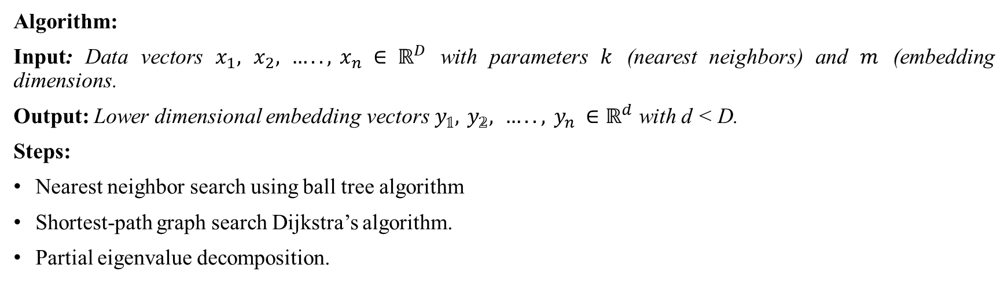
Manifold Learning: Isomap Algorithm
Algorithm:
Input: Data vectors $x_{1}, x_{2}, ….., x_{n} ∈ ℝ^{D}$ with parameters $k$ (nearest neighbors) and $m$ (embedding dimensions.
Output: Lower dimensional embedding vectors $y_{𝟙}, y_{𝟚}, ….., y_{n} ∈ℝ^{d}$ with d < D.
Steps:
Nearest neighbor search using ball tree algorithm
Shortest-path graph search Dijkstra’s algorithm.
Partial eigenvalue decomposition.
Key Components:
N: number of training data points
D: input dimension
$k$: number of nearest neighbors
d: output dimension
$Time Complexity:O\left[D\log\left(k\right)N\log\left(N\right)\right] + O\left[N^{2}\left(k+\log\left(N\right)\right)\right] + O\left[ⅆN^{2}\right]$ [13]

Slide 7
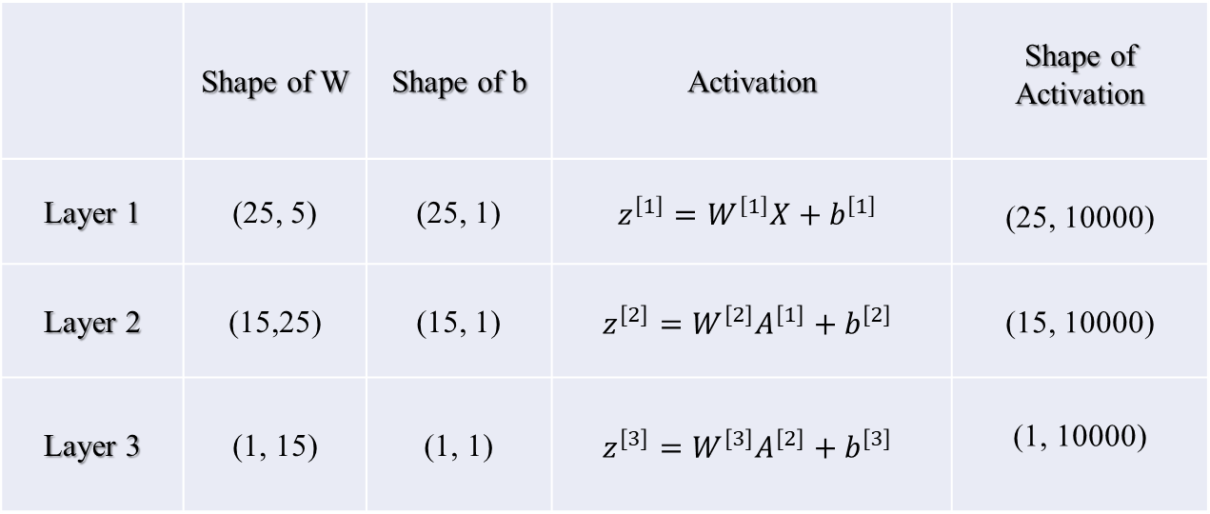
Neural Network Architecture
 | Shape of W | Shape of b | Activation | Shape of Activation
Layer 1 | (25, 5) | (25, 1) | $$z^{\left[1\right]}=W^{\left[1\right]}X+b^{\left[1\right]}$$ | (25, 10000)
Layer 2 | (15,25) | (15, 1) | $$z^{\left[2\right]}=W^{\left[2\right]}A^{\left[1\right]}+b^{\left[2\right]}$$ | (15, 10000)
Layer 3 | (1, 15) | (1, 1) | $$z^{\left[3\right]}=W^{\left[3\right]}A^{\left[2\right]}+b^{\left[3\right]}$$ | (1, 10000)
Table II: Neural Network Layers

Slide 8
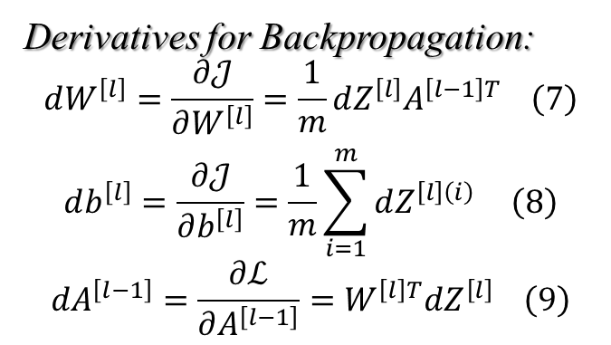
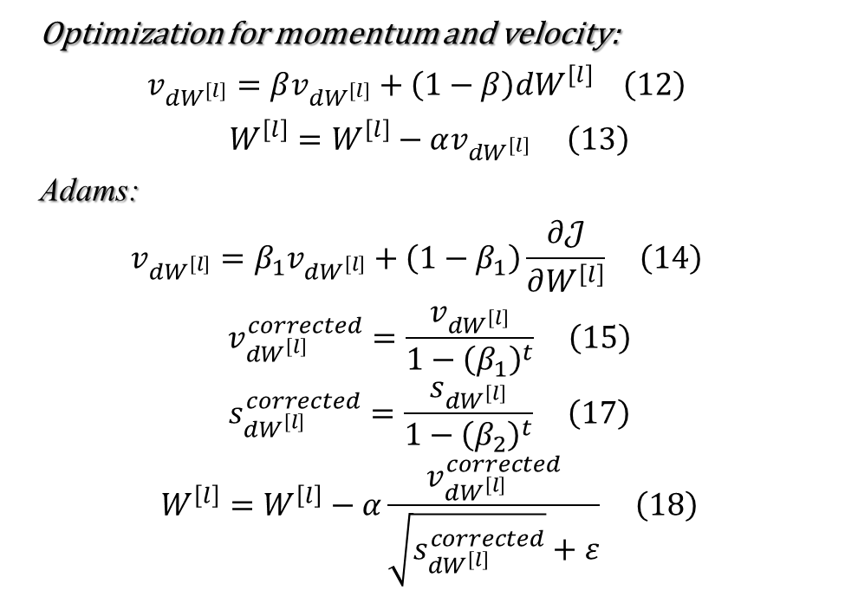
Mathematical Base:
Log loss: $ℒ\left(a^{\left(i\right)},y^{\left(i\right)}\right)=−y^{\left(i\right)}\log\left(a^{\left(i\right)}\right)−\left(1−y^{\left(i\right)}\right)\log\left(1−a^{\left(i\right)}\right)\left(5\right)$
Optimization for momentum and velocity:
$$\begin{aligned}v_{dW^{\left[l\right]}}=βv_{dW^{\left[l\right]}}+\left(1−β\right)dW^{\left[l\right]} \#\left(12\right)\end{aligned}$$
$$\begin{aligned}W^{\left[l\right]}=W^{\left[l\right]}−αv_{dW^{\left[l\right]}} \#\left(13\right)\end{aligned}$$
Adams:
$$\begin{aligned}v_{dW^{\left[l\right]}}=β_{1}v_{dW^{\left[l\right]}}+\left(1−β_{1}\right)\frac{∂𝒥}{∂W^{\left[l\right]}} \#\left(14\right)\end{aligned}$$
$$\begin{aligned}v_{dW^{\left[l\right]}}^{corrected}=\frac{v_{dW^{\left[l\right]}}}{1−{\left(β_{1}\right)}^{t}} \#\left(15\right)\end{aligned}$$
$$\begin{aligned}s_{dW^{\left[l\right]}}^{corrected}=\frac{s_{dW^{\left[l\right]}}}{1−{\left(β_{2}\right)}^{t}} \#\left(17\right)\end{aligned}$$
$$\begin{aligned}W^{\left[l\right]}=W^{\left[l\right]}−α\frac{v_{dW^{\left[l\right]}}^{corrected}}{\sqrt{s_{dW^{\left[l\right]}}^{corrected}}+ε} \#\left(18\right)\end{aligned}$$
Derivatives for Backpropagation:
$$\begin{aligned}dW^{\left[l\right]}=\frac{∂𝒥}{∂W^{\left[l\right]}}=\frac{1}{m}dZ^{\left[l\right]}A^{\left[l−1\right]T} \#\left(7\right)\end{aligned}$$
$$\begin{aligned}db^{\left[l\right]}=\frac{∂𝒥}{∂b^{\left[l\right]}}=\frac{1}{m}\sum_{i=1}^{m}{dZ^{\left[l\right]\left(i\right)}} \#\left(8\right)\end{aligned}$$
$$\begin{aligned}dA^{\left[l−1\right]}=\frac{∂ℒ}{∂A^{\left[l−1\right]}}=W^{\left[l\right]T}dZ^{\left[l\right]} \#\left(9\right)\end{aligned}$$

Slide 9
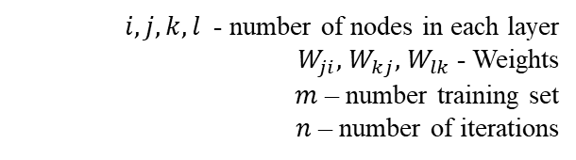
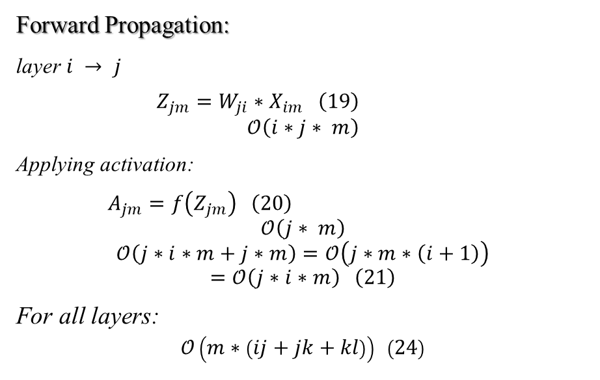
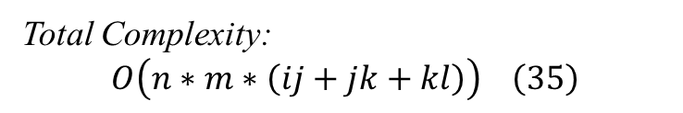
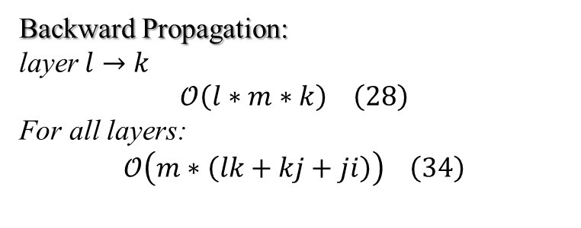
Derived Time Complexity:
Forward Propagation:
layer $ⅈ →$ $j$
$\begin{aligned}Z_{jm}=W_{ji}∗X_{im} \#\left(19\right)\end{aligned}$
$$𝒪\left(i∗j∗ m\right)$$
Applying activation:
$\begin{aligned}A_{jm}=f\left(Z_{jm}\right) \#\left(20\right)\end{aligned}$
$$𝒪\left(j∗ m\right)$$
$$𝒪\left(j∗i∗m+j∗m\right)=𝒪\left(j∗m∗\left(i+1\right)\right)$$
$$\begin{aligned}=𝒪\left(j∗i∗m\right) \#\left(21\right)\end{aligned}$$
For all layers:
$$\begin{aligned}𝒪\left(m∗\left(ij+jk+kl\right)\right) \#\left(24\right)\end{aligned}$$
Backward Propagation:
layer $l$ $→$ $k$
$$\begin{aligned}𝒪\left(l∗m∗k\right) \#\left(28\right)\end{aligned}$$
For all layers:
$$\begin{aligned}𝒪\left(m∗\left(lk+kj+ji\right)\right) \#\left(34\right)\end{aligned}$$
$ⅈ, j, k, l$ - number of nodes in each layer
$W_{ji},$ $W_{kj},$ $W_{lk}$ - Weights
$m$ – number training set
$n$ – number of iterations
Total Complexity:
$$\begin{aligned}O\left(n∗m∗\left(ij+jk+kl\right)\right) \#\left(35\right)\end{aligned}$$

Slide 10
Experimental Results
Epoch | Precision | Recall | Accuracy
1 | 76.21% | 80.74% | 75.23%
10 | 87.16% | 86.75% | 85.50%
20 | 88.48% | 87.43% | 86.66%
30 | 88.96% | 87.66% | 87.06%
Table III: Model Performance

Slide 11
Conclusion:
Need for reducing computational cost:
Real-time analysis, such as that of a web extension URL filter.
The dynamic nature of URL features necessitates frequent model training with the integration of new features.
Research results:
The disparity between our proposed model and top-performing models ranges only from 5 to 8% accuracy.
Future research endeavors will concentrate on elevating accuracy while preserving a low computational threshold.

Slide 12
References
[1] | CISCO, "Cyber security threat trends: phishing," 2021. [Online]. Available: https://umbrella.cisco.com/info/2021-cyber-security-threat-trends-phishing-crypto-top-the-list.
[2] | M. a. I. Y. a. J. A. Khonji, "Phishing Detection: A Literature Survey," IEEE Communications Surveys & amp Tutorials, pp. 1-31, 2013.
[3] | D. L. a. P. S. a. P. Glancy, "Taking the Bait: A Systems Analysis of Phishing Attacks," Procedia Manufacturing, vol. 3, pp. 1109-1116, 2015.
[4] | IBM, "Cost of a data breach report," 2022-2023. [Online]. Available: https://www.ibm.com/reports/data-breach.
[5] | APWG, "Phishing activity trends report," 2022. [Online]. Available: https://apwg.org/trendsreports/.
[6] | M. M. D. a. M. I. Vahid Shahrivari, "Phishing Detection Using Machine Learning Techniques," arXiv, 2020.
[7] | Z. a. A. R. a. A.-M. J. a. H. Q. E. U. a. S. K. a. F. M. H. Alshingiti, "A Deep Learning-Based Phishing Detection System Using CNN, LSTM, and LSTM-CNN," Electronics, vol. 12, p. 1, 2023.
[8] | H. S. a. I. R. Katherine Haynes, "Lightweight URL-based phishing detection using natural language processing transformers for mobile devices," Procedia Computer Science, vol. 191, pp. 127-134, 2021.
[9] | A. a. A. A.-H. Q. a. A. A. a. a. t. A. Odeh, "Comparative Study of CatBoost, XGBoost, and LightGBM for Enhanced URL Phishing Detection: A Performance Assessment," Journal of Internet Services and Information Security, vol. 13, pp. 1-11, 12 2023.
[10] | A. A.-A. a. S. Al-Ahmadi, "Robust URL Phishing Detection Based on Deep Learning," KSII Transactions on Internet and Information Systems, vol. 14, pp. 2752-2768, 2020.
[11] | S. Ariyadasa, S. Fernando and S. Fernando, "Phishing Websites Dataset," University of Moratuwa, Uva Wellassa University, 17 11 2021. [Online]. Available: https://data.mendeley.com/datasets/n96ncsr5g4/1.
[12] | R. M. F. T. a. L. M. Mohammad, "Phishing websites features," School of Computing and Engineering, University of Huddersfield, 2015.
[13] | J. B. T. a. V. d. S. a. J. C. Langford, "A Global Geometric Framework for Nonlinear Dimensionality Reduction," Science, vol. 290, pp. 2319-2323, 2000.
[14] | C. M. Bishop, Pattern Recognition and Machine Learning, 1 ed., Cambridge: Springer New York, NY, 2006, p. 778.
[15] | D. P. K. a. J. Ba, "Adam: A Method for Stochastic Optimization," arXiv:1412.6980, 2017.

Slide 13
Q & A

